Slide 1
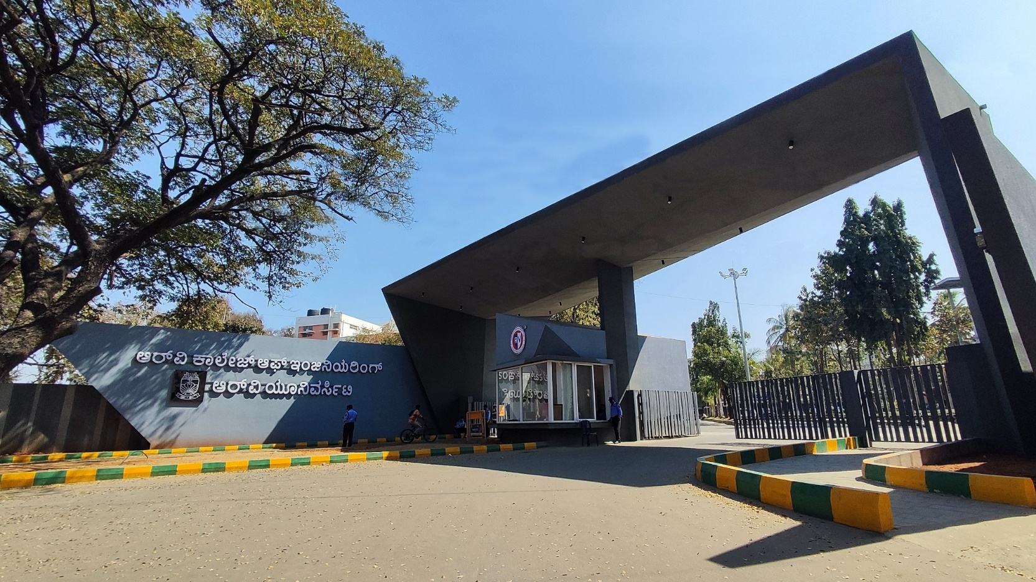
Federated Learning Framework for Early Epidemic Forecasting
CSE Cluster

Slide 2





Team Details
Avyaya S Yekkar
(1RV24CS057)
Stavan Rahul Khobare (1RV24CS284)
Dr. Krishnappa H K
Professor-CSE Department
Kaizen S
(1RV24CY025 )
Rohith S Panchamukhi (1RV24CS234)
1st April, 2026

Slide 3
EL Phase-I
Presentation Outline
Introduction
Literature Review
Problem Definition
Objectives
Methodology
Subject Relevance
Proposed Outcomes
Timeline of the project
Conclusion
References
1st April, 2026

Slide 4
Introduction
Explainable Federated Learning Framework for Early Epidemic Forecasting is a privacy-preserving artificial intelligence framework that enables multiple healthcare institutions to collaboratively predict dengue and malaria outbreaks without sharing sensitive patient data. By integrating federated learning, temporal graph neural networks, and automated text anonymization, the system provides actionable outbreak forecasts with built-in explanations, directly supporting SDG 3.3 (combating epidemics) and SDG 3.8 (universal health coverage).
Dengue and malaria collectively affect over 400 million people annually, yet current surveillance systems detect outbreaks only after widespread transmission, missing critical opportunities for early intervention.
Privacy regulations prevent hospitals from sharing patient data, creating isolated silos that hide cross-institutional outbreak patterns a gap this framework bridges through federated learning without compromising data sovereignty.
1st April, 2026

Slide 5
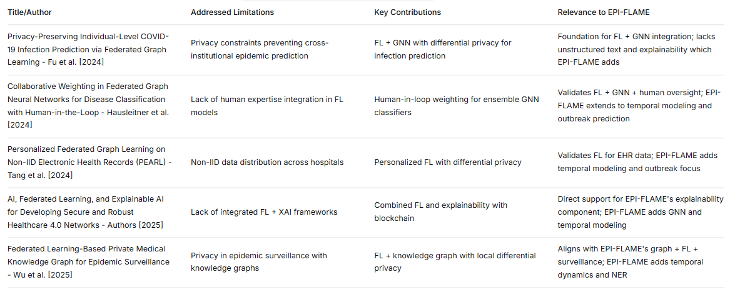
Literature Review
1st April, 2026

Slide 6
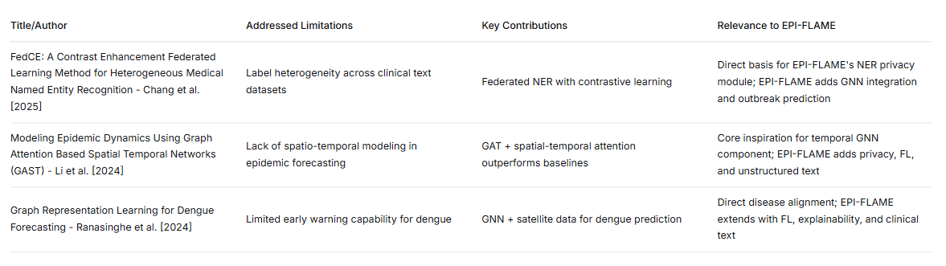
Literature Review
1st April, 2026

Slide 7
Problem Definition
Clear statement of the problem: Existing outbreak prediction systems for dengue and malaria are limited by centralized learning approaches, lack of privacy preservation, insufficient spatio-temporal modeling, and minimal explainability. These limitations make it difficult to generate early, accurate, and interpretable outbreak forecasts using distributed healthcare data from multiple institutions. Therefore, there is a need for a unified framework that can securely integrate multi-source data and provide reliable predictions for timely public health intervention.
1st April, 2026

Slide 8
Problem Definition
Context of the Problem: Vector-borne diseases like dengue and malaria continue to pose a major global health challenge, particularly in densely populated and climate-sensitive regions. The spread of these diseases is influenced by multiple factors such as weather conditions, population density, hospital case trends, and clinical observations over time. Traditional surveillance approaches primarily rely on historical case counts and manual reporting, which often fail to capture temporal and spatial spread patterns at an early stage.
Moreover, a large portion of clinically useful information exists in unstructured physician notes and hospital records, which is frequently underutilized by conventional analytical models. Existing AI-based forecasting approaches often lack privacy preservation, interpretability, and fairness considerations, making them less suitable for real-world deployment in healthcare environments.
1st April, 2026

Slide 9
Problem Definition
Significance of Addressing the Problem: Explain Failure to address this problem can lead to delayed outbreak warnings, increased infection rates, higher mortality, and severe strain on healthcare infrastructure. Without an effective predictive surveillance framework, health authorities may be forced to act only after outbreaks have escalated, reducing the effectiveness of containment measures such as vector control, resource allocation, and public advisories.
The major gaps that arise if this issue is not addressed include:
Delayed outbreak response, leading to preventable spread of disease
Lack of collaboration across healthcare institutions due to privacy constraints
Underutilization of critical clinical data, especially unstructured notes
Limited trust in AI predictions because of poor explainability
Potential healthcare disparities, as underserved regions may receive less accurate predictions
Addressing this problem is therefore essential for enabling proactive, privacy-preserving, and explainable epidemic forecasting, which can support timely decision-making and improve public health outcomes.
1st April, 2026

Slide 10
Objectives
Main Objective: To develop a privacy-preserving and explainable AI framework for early forecasting of dengue and malaria outbreaks using spatio-temporal healthcare data.
Specific Objectives:
To design a spatio-temporal graph-based model for predicting outbreak risk across regions and time periods.
To enable privacy-preserving collaborative learning across multiple healthcare institutions using federated learning.
To incorporate explainability mechanisms that provide interpretable outbreak predictions for public health officials.
To integrate multi-source data such as case records, environmental factors, and hospital trends for improved forecasting accuracy.
1st April, 2026

Slide 11
Objectives
Expected Contributions to the Field:
Addresses the gap of privacy-preserving collaborative learning across multiple healthcare institutions using federated learning.
Solves the lack of early, explainable outbreak prediction through spatio-temporal GNN-based forecasting.
Bridges the missing integration of multi-source data, including case records, environmental factors, and hospital networks..
1st April, 2026

Slide 12
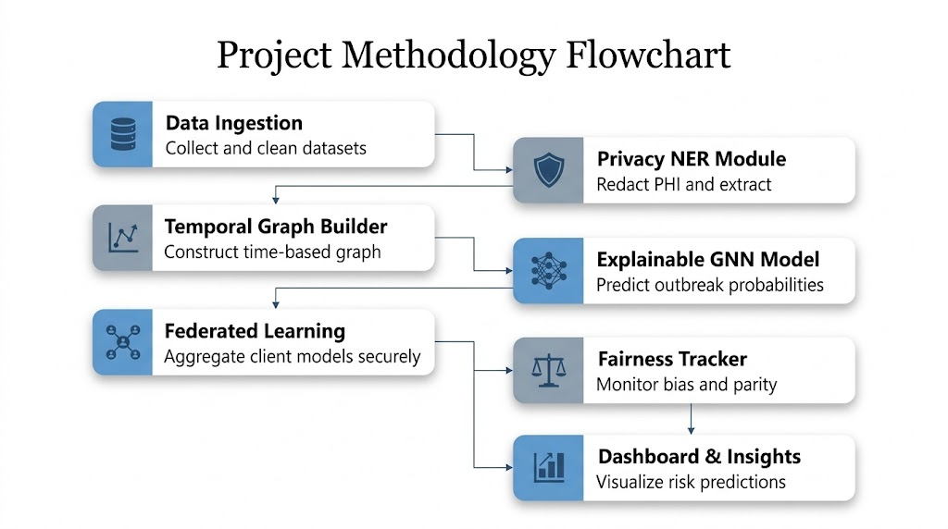
Methodology
Data Ingestion: Collects, cleans, and aligns multi-source outbreak, weather, and hospital datasets.
Privacy NER Module: Removes sensitive patient information and extracts relevant clinical entities from text data.
Temporal Graph Builder: Converts region and hospital data into time-based graph structures for spread modeling.
Explainable GNN Model: Learns spatial and temporal disease patterns to predict outbreak risk with interpretability.
Federated Learning: Trains local hospital models independently and securely aggregates updates into a global model.
Fairness Tracker: Evaluates bias and ensures consistent prediction performance across regions and populations.
Dashboard & Insights: Displays outbreak risk scores, hotspot alerts, and explainable decision insights.
1st April, 2026

Slide 13
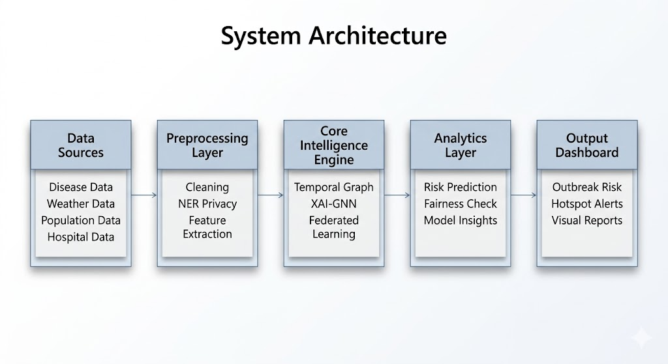
Methodology
Data Sources: Ingests multi-domain inputs including epidemiological, environmental, demographic, and hospital network data.
Preprocessing Layer: Standardizes raw data through cleaning, privacy preservation, and feature extraction for model readiness.
Core Intelligence Engine: Performs graph-based learning, federated model training, and explainable outbreak prediction.
Analytics Layer: Generates risk scores, fairness assessments, and interpretable model insights for decision support.
Output Dashboard: Presents outbreak alerts, hotspot visualization, and actionable reports for stakeholders.
1st April, 2026

Slide 14
Methodology
Tools and Resources Used:
Python – core development and data processing
PyTorch Geometric – temporal graph neural networks
Flower / OpenFL – federated learning framework
scispaCy / ClinicalBERT – NER and clinical text processing pandas, NumPy – preprocessing and analysis
Streamlit / Power BI – visualization dashboard
NASA POWER Dataset – weather parameters such as temperature, rainfall, and humidity
DengueHub / CDC Dengue Dataset – historical dengue case records for outbreak trend analysisMalaria Atlas Project – malaria prevalence and regional surveillance data
1st April, 2026

Slide 15
Subject Relevance
DMS (Discrete Mathematics):
Graph Theory: Modeling hospitals, regions, and disease spread as nodes and edges
Set Theory & Relations: Defining interconnections between patients, hospitals, and geographic regions
Logic & Probability: Risk estimation and outbreak classification decisions
DAA (Design and Analysis of Algorithms)
Graph Traversal & Path Analysis: Modelling disease spread pathways across regions
Optimization Algorithms: Efficient federated aggregation and model update strategies
Complexity Analysis: Evaluating time and space efficiency of GNN and forecasting pipeline
CN (Computer Networks)
Distributed Communication: Secure model update exchange between hospital clients and central server
Client-Server Architecture: Federated learning workflow across multiple simulated hospitals
Data Security & Privacy: Secure transmission of local model parameters
1st April, 2026

Slide 16
Subject Relevance
SDGs (Sustainable Development Goals)
SDG 3 – Good Health and Well-Being: Early epidemic detection and timely intervention
SDG 9 – Industry, Innovation and Infrastructure: AI-driven healthcare intelligence systems
SDG 11 – Sustainable Cities and Communities: Better urban outbreak preparedness
1st April, 2026

Slide 17
Proposed Outcomes
Expected Results:
Early Outbreak Forecasting: Predict dengue and malaria outbreak risk in advance with improved accuracy.
Privacy-Preserving Surveillance: Enable secure collaborative analysis without sharing sensitive healthcare data.
Explainable Decision Support: Provide interpretable risk insights for timely public health intervention.
Potential Impact on the Field: The project can support proactive public health decision-making, better resource allocation, and advancement of AI-driven disease surveillance systems.
Future Research Directions: The framework can be extended to other infectious diseases, real-time hospital networks, and advanced multimodal epidemic forecasting models.
1st April, 2026

Slide 18
Timeline of the project
Project Timeline Overview
Initiation Phase (Weeks 1-2)
Define project scope and objectives
Finalize datasets, tools, and methodology
Conduct feasibility and literature review.
Planning Phase (Weeks 3-4)
Prepare detailed workflow and task timeline.
Allocate resources and assign responsibilities.
Finalize system architecture and milestones.
Execution Phase (Weeks 5-10)
Data collection and preprocessing.
Federated learning and explainability integration.
Model development and training.
Regular progress reviews and testing
Closure Phase (Weeks 11-13)
Complete final model and dashboard
Prepare documentation and presentation.
Project review, feedback incorporation, and final submission.
1st April, 2026

Slide 19
Conclusion
Summary of Key Points:
Developed a privacy-preserving and explainable AI framework for early dengue and malaria outbreak forecasting.
Integrated spatio-temporal graph learning, federated learning, and multi-source healthcare datasets for predictive surveillance.
Aimed to support timely public health interventions and better resource planning through actionable outbreak insights.
Final Thoughts: This project demonstrates how advanced AI techniques can transform traditional reactive disease monitoring into a proactive, data-driven surveillance system..
Call to Action or Next Steps: Future work includes real-time deployment with hospital networks, expansion to additional infectious diseases, and enhanced multimodal forecasting capabilities..
1st April, 2026

Slide 20
References
[1] W. Fu, H. Li, Y. Liu, S. Xia, and H. Chen, “Privacy-preserving individual-level COVID-19 infection prediction via federated graph learning,” ACM Transactions on Information Systems, vol. 42, no. 4, pp. 1–28, Apr. 2024.
[2] C. Hausleitner, H. Mueller, A. Holzinger, and B. Pfeifer, “Collaborative weighting in federated graph neural networks for disease classification with the human-in-the-loop,” Scientific Reports, vol. 14, p. 21839, Sep. 2024, doi: 10.1038/s41598-024-72748-7.
[3] K. Chang, H. Sun, J. Wan, et al., “FedCE: A contrast enhancement federated learning method for heterogeneous medical named entity recognition,” Tsinghua Science and Technology, vol. 30, no. 6, pp. 2384–2398, Jul. 2025, doi: 10.26599/TST.2024.9010186.
[4] R. Li, S. Chen, Y. Li, and X. Zhang, “Modeling epidemic dynamics using graph attention based spatial temporal networks (GAST),” PLoS ONE, vol. 19, no. 9, p. e0307159, Sep. 2024, doi: 10.1371/journal.pone.0307159.
[5] L. Wang, A. Adiga, J. Chen, A. Sadilek, S. Venkatramanan, and M. Marathe, “CausalGNN: Causal-based graph neural networks for spatio-temporal epidemic forecasting,” in Proc. 36th AAAI Conf. Artificial Intelligence (AAAI), Virtual, Feb. 2022, pp. 12191–12199.
[6] G. S. K. Ranasinghe, S. S. L. Weerasinghe, and R. K. M. S. S. Rathnayake, “Graph representation learning for dengue forecasting,” in Proc. IEEE Int. Conf. Big Data (BigData), Washington, DC, USA, Dec. 2024, pp. 1–6, doi: 10.1109/BigData62323.2024.10825335.
[7] T. Tang et al., “Personalized federated graph learning on non-IID electronic health records,” IEEE Transactions on Neural Networks and Learning Systems, vol. 35, no. 9, pp. 11843–11856, Sep. 2024, doi: 10.1109/TNNLS.2024.3370297.
[8] “Research on classification method of infectious diseases in population mobility based on bipartite interactive graph neural network algorithm,” in Proc. IEEE Int. Conf. Computing, Networking and Communications (ICNC), Tokyo, Japan, Mar. 2024, pp. 1–6, doi: 10.1109/ICNC59896.2024.11012080.
[9] “AI, federated learning, and explainable AI for developing secure and robust Healthcare 4.0 networks,” in Proc. IEEE Int. Conf. Innovative Computing, Intelligent Communication and Smart Electrical Systems (ICSES), Raigarh, India, Apr. 2025, pp. 1–6, doi: 10.1109/ICSES60034.2025.11071020.
1st April, 2026

Slide 21

1st April, 2026

